Slide 1
Live 360! Events
Conference Review
Follow along at:
http://bit.ly/15u1FQ8 or http://html5demo1.azurewebsites.net/
Presented by Darek Tomyn
Darek.Tomyn@solvera.ca
Notes:
Was allowed the opportunity of attending a conference in December called Live360. This presentation had its genesis from attending this.
You may access all of the material for the event by going to the following link
http://www.redmondevents.com/virtual/login.aspx?ReturnUrl=%2fvirtual%2fvslive%2f2012%2flive360%2fDefault.aspx
Username: LIVE!360
Password: Orlando4in1

Slide 2
Quick Summary
Historically, Visual Studio Live annual event in Orlando
1st time “combined 4 events into 1”:
Visual Studio
SharePoint
SQL Server
Cloud & Virtualization
Often there were 16 sessions happening at once!
First and last days were “workshops”
Microsoft technologies but not hosted by Microsoft

Slide 3
What my objectives were…
HTML 5…
learn more including the “state” of it and how to get browsers to work with it
Azure…
what “state” is it in? How to use, etc
Mobile…
Windows phone… but looked like sessions were lacking
Any trends?

Slide 4
What I learnt
Big Data
Azure
Other…
HTML 5
Websites
History
<audio>
<video>
SharePoint
CSS3
<canvas>
svg
Modernizr
Tags: Simplification and Semantic
MVC 4
<form> enhancements
OAuth
SignalR
Browser
Support
SQL Server 2012 New Features
jQuery mobile
VS ALM
Nuget
Git
Bitly

Slide 5
What I learnt
Big Data
Azure
Other…
HTML 5
Websites
History
<audio>
<video>
SharePoint
CSS3
<canvas>
svg
Modernizr
Tags: Simplification and Semantic
MVC 4
<form> enhancements
OAuth
SignalR
Browser
Support
SQL Server 2012 New Features
jQuery mobile
VS ALM
Nuget
Git
Bitly

Slide 6
HTML 5 History
Wee bit of history¹:
HTML (1991), HTML2 (1994), HTML3 (1995), HTML3.2 & 4 (1997), XHTML1 (2000), XHTML 1.1 (2001)
W3C wanted XHTML 2… but was very strict standard
Browser group formed WHATWG² and created HTML5
W3C’s XHTML 2 ultimately died on July 2, 2009
WHATWG gave W3C permission to publish HTML 5… so really are 2 “specs” out there
Notes:
¹For an interesting “history” read, check out http://html5forwebdesigners.com/history/index.html
²WHATWG is an acronym for the “Web Hypertext Application Technology Working Group” http://www.whatwg.org/

Slide 7


HTML 5 History
Apple’s affect:
“The world is moving to HTML 5” – Steve Jobs
iDevices have no support for Flash
Logo
Marketing material

Slide 8
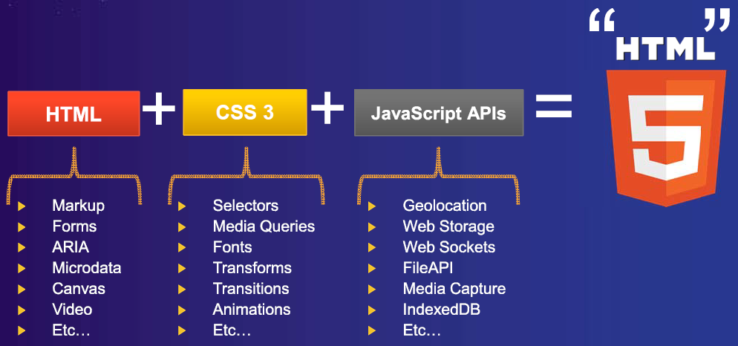
HTML 5 – What is it?
What is it? HTML + CSS3 + JavaScript APIs

Slide 9
What I learnt
Big Data
Azure
Other…
HTML 5
Websites
ü
<audio>
<video>
History
SharePoint
CSS3
<canvas>
svg
Modernizr
Tags: Simplification and Semantic
MVC 4
<form> enhancements
OAuth
SignalR
Browser
Support
SQL Server 2012 New Features
jQuery mobile
VS ALM
Nuget
Git
Bitly

Slide 10
HTML 5 – Simplification
<!DOCTYPE html PUBLIC "-//W3C//DTD XHTML 1.0 Strict//EN" "http://www.w3.org/TR/xhtml1/DTD/xhtml1-strict.dtd">
<!DOCTYPE html>
<html lang="en" xmlns="http://www.w3.org/1999/xhtml" xml:lang="en">
<html lang="en">
<meta http-equiv="Content-Type" content="text/html; charset=utf-8" />
<meta charset="utf-8">
Some others:
The type attribute is no longer required on <style> and <script> tags
Elements that are by nature self-closing now do not need “/”
img
br

Slide 11
HTML 5 – New Tags
<div id=“header”>
<header>
<div id=“nav”>
<nav>
<div id=“aside”>
<section>
<article>
<aside>
<div id=“section”>
<div id=“article”>
<footer>
<div id=“footer”>

Slide 12
What I learnt
Big Data
Azure
Other…
HTML 5
Websites
ü
<audio>
<video>
History
SharePoint
CSS3
<canvas>
svg
Modernizr
Tags: Simplification and Semantic
MVC 4
<form> enhancements
ü
OAuth
SignalR
Browser
Support
SQL Server 2012 New Features
jQuery mobile
VS ALM
Nuget
Git
Bitly

Slide 13
HTML 5 - Browser Support
Spec moves through:
1st Published Working Draft -> Working Draft -> Last Call -> Candidate Recommendation -> Recommendation
IE goal is CR and up … as a result, they “score” much lower… but are getting better
One easy option is Google Chrome Frame for <=8¹
Don’t sniff browsers… test for features
Html5test.com, CanIuse.com, and lots of others
Adoption strategies: lowest common denominator, polyfill² enriched
DEMO 1 – 3
http://html5demo1.azurewebsites.net/Index.html
Notes:
¹ Chrome browser engine in IE 6/7/8/9
chrome=1 - Always active
chrome=IE7 - Active for IE major version 7 or lower
chrome=IE8 - Active for IE major version 8 or lower
² Polyfill is JavaScript that implants HTML5 functionality in a browser that does not offer native support. See: http://remysharp.com/2010/10/08/what-is-a-polyfill/ or https://github.com/Modernizr/Modernizr/wiki/HTML5-Cross-browser-Polyfills

Slide 14
What I learnt
Big Data
Azure
Other…
HTML 5
Websites
ü
<audio>
<video>
History
SharePoint
CSS3
<canvas>
svg
Modernizr
Tags: Simplification and Semantic
MVC 4
<form> enhancements
ü
OAuth
SignalR
Browser
Support
Mobile general
ü
SQL Server 2012 New Features
jQuery mobile
VS ALM
Nuget
Git
Bitly

Slide 15
HTML 5 Form Enhancements
<input type=
Email, url, search, number, date, time, color, etc
New attributes
Placeholder, autofocus
Contenteditable
Remember sites mentioned previously: Html5test.com, canIuse.com
Demo 4
http://html5demo1.azurewebsites.net/Demo04-NewInputTypes.html

Slide 16
What I learnt
Big Data
Azure
Other…
HTML 5
Websites
ü
<audio>
<video>
History
SharePoint
CSS3
<canvas>
svg
Modernizr
Tags: Simplification and Semantic
MVC 4
<form> enhancements
ü
ü
OAuth
SignalR
Browser
Support
Mobile general
ü
SQL Server 2012 New Features
jQuery mobile
VS ALM
Nuget
Git
Bitly

Slide 17
HTML 5 MultiMedia Enhancements
New “audio” and “video” tags
Demo 5
http://html5demo1.azurewebsites.net/Demo05-Multimedia.html

Slide 18
What I learnt
Big Data
Azure
Other…
HTML 5
Websites
ü
<audio>
ü
History
<video>
SharePoint
CSS3
<canvas>
svg
Modernizr
Tags: Simplification and Semantic
MVC 4
<form> enhancements
ü
ü
OAuth
SignalR
Browser
Support
Mobile general
ü
SQL Server 2012 New Features
jQuery mobile
VS ALM
Nuget
Git
Bitly

Slide 19
Azure
What is it?
cloud computing is really doing just-in-time provisioning and scaling of services, software and solutions delivered as a service on a pool of hardware
On demand provisioning
scaling resources... example “tonight I need 10,000 nodes for an hour until batch is done”
abstraction over resources
Demo 6
Create a website using Azure… show other options here
https://manage.windowsazure.com
Link to my github repository
Create new site and download publish settings for deploying in Visual Studio

Slide 20
What I learnt
Big Data
Azure
Other…
HTML 5
Websites
ü
ü
ü
<audio>
ü
History
<video>
SharePoint
CSS3
<canvas>
svg
Modernizr
Tags: Simplification and Semantic
MVC 4
<form> enhancements
ü
ü
OAuth
SignalR
Browser
Support
Mobile general
ü
SQL Server 2012 New Features
jQuery mobile
VS ALM
Nuget
Git
Bitly

Slide 21
Mobile
Unfortunately not the conference to learn a lot of mobile
Concentration on HTML5 including CSS3 for formatting with mobile in mind
3 good takeaways
JSON for serialized data for smaller payload
Opera mobile emulator
By default, add the below “viewport” to all web pages:
<meta name="viewport" content="width=device-width, user-scalable=no">
Demo 7
Opera mobile emulator
Page with and without meta tag

Slide 22
What I learnt
Big Data
Azure
Other…
HTML 5
Websites
ü
ü
ü
<audio>
ü
History
<video>
SharePoint
CSS3
<canvas>
svg
Modernizr
Tags: Simplification and Semantic
MVC 4
<form> enhancements
ü
ü
OAuth
SignalR
Browser
Support
Mobile general
ü
ü
SQL Server 2012 New Features
jQuery mobile
VS ALM
Nuget
Git
Bitly

Slide 23
Trends - SignalR
Makes real-time HTTP so easy it seems like “magic” ¹
An open source series of libraries that provide an abstraction around persistent HTTP connections²
Demo 8
Start up demo site on Azure
2 different demos here:
HitCounter
Chat
Notes:
¹ “Any sufficiently advanced technology is indistinguishable from magic” – Arthur C. Clarke
² http://www.asp.net/signalr/

Slide 24
What I learnt
Big Data
Azure
Other…
HTML 5
Websites
ü
ü
ü
<audio>
ü
History
<video>
SharePoint
CSS3
<canvas>
svg
Modernizr
Tags: Simplification and Semantic
MVC 4
<form> enhancements
ü
ü
OAuth
SignalR
ü
Browser
Support
Mobile general
ü
ü
SQL Server 2012 New Features
jQuery mobile
VS ALM
Nuget
Git
Bitly

Slide 25
Other observations
Nuget
Visual Studio add-in to import in external resources easily
Git
Cvs -> svn -> git
Bit.ly
Less and less people using tinyurl.com
“Big data”
still in infancy (IMO)

Slide 26
Overall Opinion of Conference
While there…
Wanted more… more HTML 5, more mobile
Logistics… felt could have been better
Accomodations… beautiful, close to Universal Studios
Not a “swag” conference
Looking back…
I am surprised at how much I did actually learn… or at least spark an interest in
Would recommend in the future
Ability to jump from session to session because of so many running concurrently was a big benefit

